Slide 1
DATA FLOW DIAGRAM - DFD

Slide 2
Key Definitions
Process model
  A formal way of representing how a business system operates.
  Illustrates the activities that are performed and how data moves among them.
Data flow diagramming
  A common technique for creating process models

Slide 3
Key Definitions
Logical process models describe processes without suggesting how they are conducted.
Physical process models provide information that is needed to build the system.

Slide 4
DFD example

Slide 5
Elements of a DFD
Process
  An activity or function performed for a specific business reason.
  Manual or computerized.
Data flow
  A single piece of data or a logical collection of data.
  Always starts or ends at a process.

Slide 6
Elements of a DFD
Data Store
  A collection of data that is stored in some way.
  Data flowing out is retrieved from the data store.
  Data flowing in updates or is added to the data store.
External entity
  A person, organization, or system that is external to the system but interacts with it.

Slide 7
Elements of a DFD

Slide 8
Using a DFD to Define Business
Processes
Business processes are too complex to be shown on a single DFD.
Decomposition is the process of representing the system in a hierarchy of DFD diagrams.
Child diagrams show a portion of the parent diagram in greater detail.

Slide 9
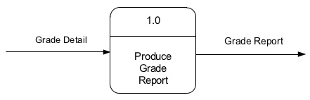
Process
Work or action performed on data (inside the system).
Labels should be verb phrases.
Receives input data and produces output.

Slide 10
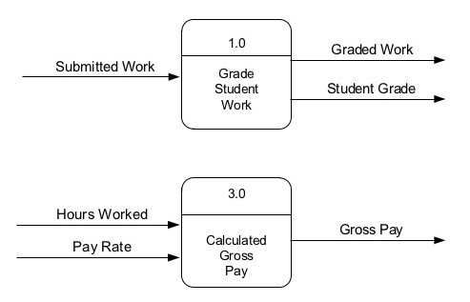
Process
Can have more than one outgoing data flow or more than one incoming data flow.

Slide 11
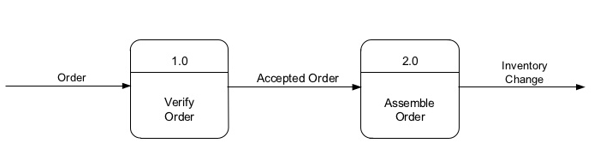
Process
Can connect to any other symbol (including another process symbol).

Slide 12
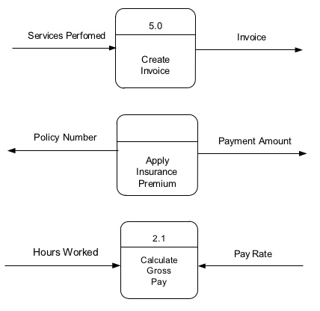
Process: correct/incorrect

Slide 13
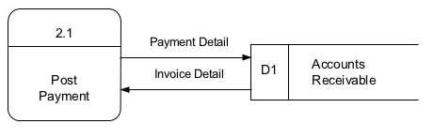
Data flow
Is a path for data move from one part of the information system to another.
Arrows depicting movement of data.
Can represent flow between process and data store by two separate arrows.
Labels should be noun phrases.

Slide 14
Alternative Data Flows
Where a process can produce different data flows given different conditions.
We show both data flows and use the process description to explain why they are alternatives.
Tip -- alternative data flows often accompany processes with IF statements.

Slide 15

Data store
Is use in a DFD to represent data that the system stores.
Labels should be noun phrases.

Slide 16
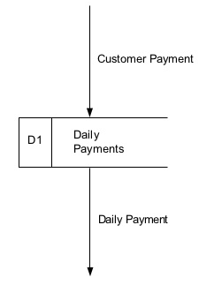
Data store
Must have at least one incoming data flow and one outgoing data flow.

Slide 17
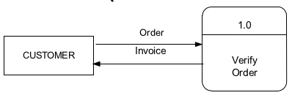
Source/Sink (external entity)
External entity that is origin or destination of data (outside the system).
Is the singular form of a department, outside organization, other information system, or person.
Labels should be noun phrases.
Source – Entity that supplies data to the system.
Sink – Entity that receives data from the system.

Slide 18
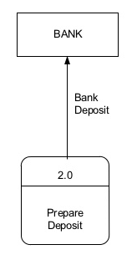
Source/Sink (external entity)
Must be connected to a process by a data flow.

Slide 19
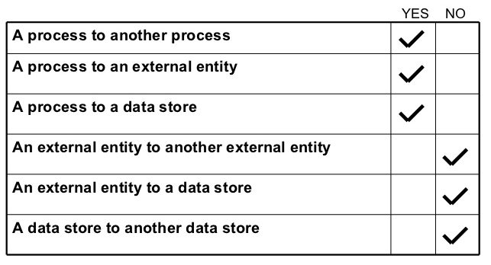
Data flow that connects

Slide 20
Context Diagram
First DFD in every business process.
Shows the context into which the business process fits.
Shows the overall business process as just one process (process 0).
Shows all the external entities that receive information from or contribute information to the system.

Slide 21
Level 0 Diagram
Shows all the major processes that comprise the overall system – the internal components of process 0.
Shows how the major processes are interrelated by data flows.
Shows external entities and the major processes with which they interact.
Adds data stores.

Slide 22
Lower-Level Diagrams
Functional Decomposition
  An iterative process of breaking a system description down into finer and finer detail.
  Uses a series of increasingly detailed DFDs to describe an IS.
Balancing
  The conservation of inputs and outputs to a data flow process when that process is decomposed to a lower level.
  Ensures that the input and output data flows of the parent DFD are maintained on the child DFD.

Slide 23
Strategies for Developing DFDs
Top-down strategy
  Create the high-level diagrams (Context Diagram), then low-level diagrams (Level-0 diagram), and so on.
Bottom-up strategy
  Create the low-level diagrams, then higher-level diagrams

Slide 24
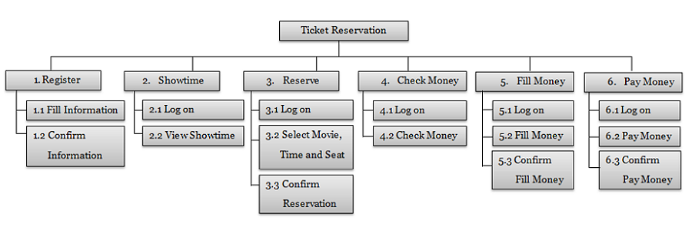
Functional Decompositon Diagram

Slide 25
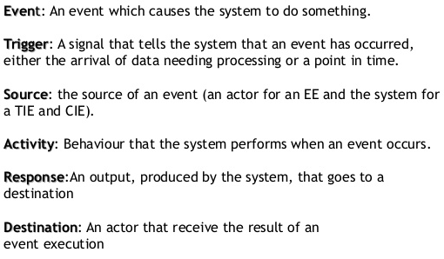
Event table
Event | Trigger | Source | Activity | Response | Destination | Retrieving data store | Updating data store

Slide 26
Process specification

Slide 27
Process Specifications
The methods available for documenting and analyzing the logic of structured decisions include structured English, decision tables, and decision trees.
Process specifications are created for primitive processes and some higher level processes on a data flow diagram.
They are also called minispecs.

Slide 28
Goal of Creating Process Specifications
Reduce process ambiguity.
Obtain a precise description of what is accomplished.
Validate the system design, including data flow diagrams and the data dictionary.

Slide 29
Process Specification Format
The process number, which must match the process ID on the data flow diagram.
The process name, the same as displays within the process symbol on the DFD.
A brief description of what the process accomplishes.
A list of input and output data flow, using the names found on the data flow diagram.
A description of the process logic. This should state policy and business rules, not computer language pseudocode.

